Slide 1
Long Range Facility Plan: Public Participation Session 1 January 13, 2022
School District No. 69 (Qualicum)

Slide 2
Agenda
(Start Recording)
Welcome and Acknowledgment of the Territory
Introduction of Trustees and Staff who are present
Overview of the LRFP purpose, scope, timelines and a description of public participation
A brief overview of School District enrolment and capacity information
Potential responses to capacity pressures
Suggested topics for discussion
Questions from the audience and discussion with attending Trustees and Staff
Clarification of various means for collection of stakeholder input*

Slide 3
Long Range Facilities Plan
Typically sets District direction for its facilities over a 5-10 year timeline - with revisions done as necessary
Gives clarity and direction to staff during that time
Improves efficiency in operations work flow
Eliminates waste in local capital spending
Improves transparency and trust with stakeholders
*Gives potential access to Ministry capital funding*
Public consultation to occur through January and February and continuing as necessary
Submission deadline June 30th for Five Year Capital Plan

Slide 4
Public Participation

Slide 5
FacTors for Board consideration
The Board will consider ALL of these factors, then THEY will vote!

Slide 6
Suggested Topics for Discussion
Projections and capacities, ways to create space, and setting priorities for responding to growth enrollment*
Programs of choice, appropriate criteria, and locations of programs, including French immersion, and the resulting transportation implications
New possibilities for existing sites, including community HUB or carbon neutral pilot schools, or relocation of the SBO
Maintenance and disposal of existing School District properties

Slide 7
Stages of Enrollment Pressure – Common Language
Below capacity – less than 70 percent of stated capacity
Approaching capacity – between 70 and 90 percent
At capacity - between 90 and 100 percent
Exceeding capacity – more than 100 percent of stated capacity, with flexible spaces or portables used as standard classrooms

Slide 8
Projections
Current enrollment is about 4300 in our school sites (not incl. CEAP/PASS)
Site capacity of School District with current usage is about 4700
Maximizing current usage of existing sites could add 200+ seats to capacity
Total School District enrolment is expected to increase slowly over the next 10 years with a peak of 4500 (not incl. CEAP/PASS)
Restoring latent spaces in all District sites increases capacity to about 5900
In Summary: Current site configuration may meet future enrollment needs, and reactivating latent space can easily meet additional demands

Slide 9
Responses to Growth
Extend existing space by converting some flexible learning spaces into standard classrooms
Extend existing space by converting all flexible learning spaces into standard classrooms
Redraw catchment boundaries to divert students to schools with capacity
Reactivate latent space in annex-sized clusters of 4-6 classrooms
Reactivate latent space by reopening entire school sites
Purchase modular buildings and place them on existing school sites where practicable
Purchase portables and place them on exiting sites where practicable

Slide 10
Suggested Topics for Discussion
Projections and capacities, ways to create space, and setting priorities for responding to growth enrollment*
Programs of choice, appropriate criteria, and locations of programs, including French immersion, and the resulting transportation implications
New possibilities for existing sites, including community HUB or carbon neutral pilot schools, or relocation of the SBO
Maintenance and disposal of existing School District properties

Slide 11
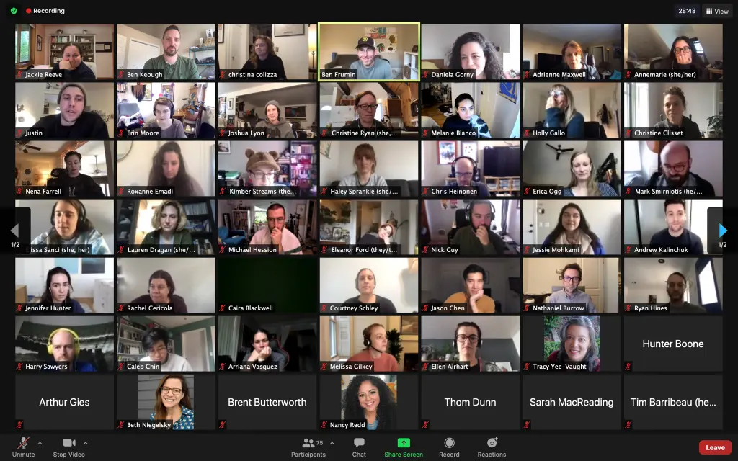
Okay, Let’s Talk!

Slide 12
Tell us More:
Email responses to:
FacilitiesPlanning@sd69.bc.ca
Enter information into the form:
https://forms.gle/rfMrWbAktt4WQrhH7

Slide 13
Thanks for joining us, tonight!

